Slide 1
Olist Marketing and Retail Analytics - Capstone Project

Slide 2
Agenda
Problem statement
Visualizations
Insights
Recommendations
Appendix –
•Data Methodology
•Data Assumptions

Slide 3
Problem statement
•OList is an e-commerce company that has faced some losses recently and they want to manage their inventory so as to reduce any unnecessary costs.
•The company would need to store tons of products in warehouses. Since storing these products adds to the costs that the company incurs.
•To be able to meet the demands of the customers, it is necessary for the organization to plan their inventory well.

Slide 4
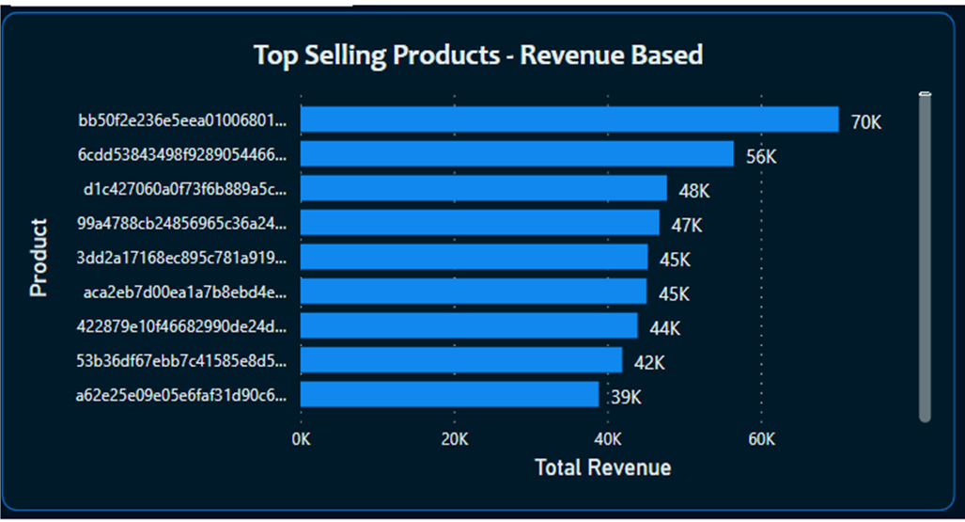
Top products ordered by revenue
The highest revenue generation is 76.03% which belongs to the Toys Category.
Most of the products in the Top list generating high revenue belong to the Toys category
The highest revenue generation is 76.03% which belongs to the Toys Category.
Most of the products in the Top list generating high revenue belong to the Toys category

Slide 5
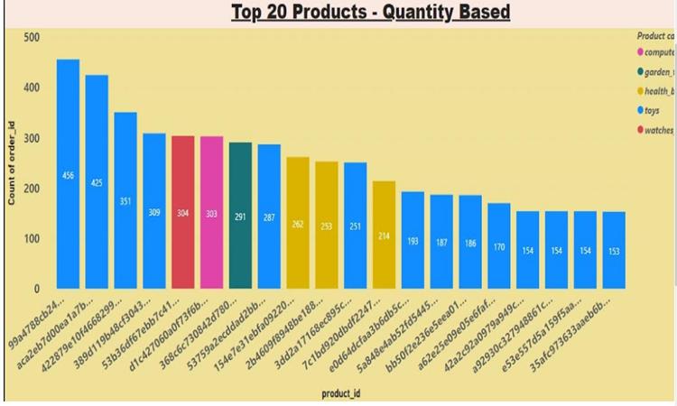
Top 20 products ordered by quantity
The highest ordered product is from the Toys category.
The top 20 quantity based orders belong to toys, watches_gifts, garden tools and health_beauty.
The highest ordered product is from the Toys category.
The top 20 quantity based orders belong to toys, watches_gifts, garden tools and health_beauty.

Slide 6
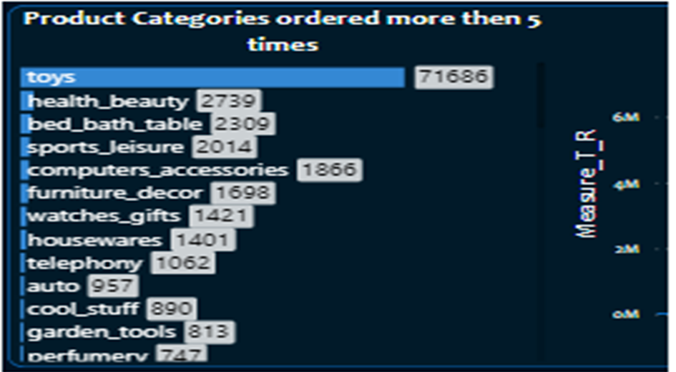
Product category ordered more than 5 times.
The most ordered category was Toys with a total of 71,686 orderd.
Health_beauty,bed_bath_table, sports_leisure were the next most ordered category.

Slide 7
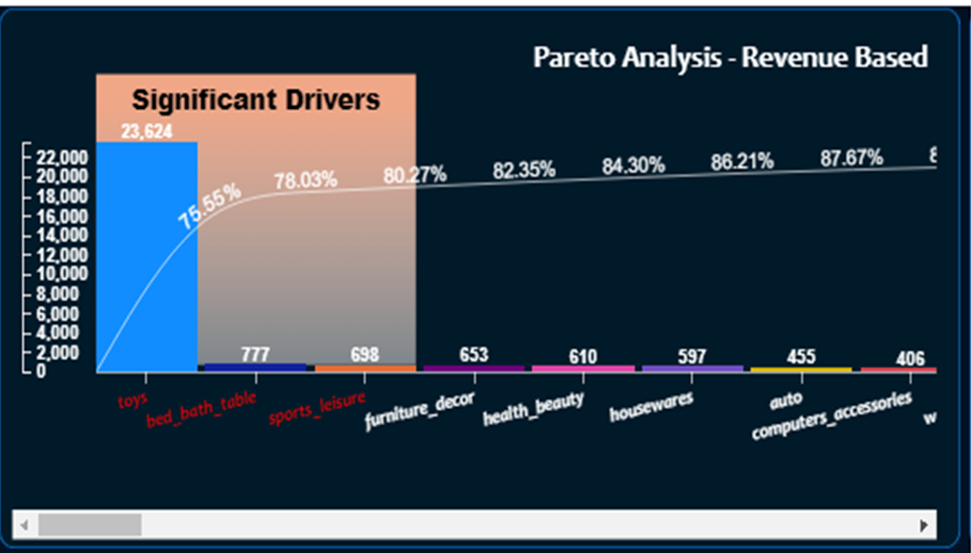
Revenue based Pareto analysis
•Toys, health_beauty and watches_gift combine generate 80.27% of the revenue.
•Toys alone generates 75.55% of the revenue.
•The rest of the 70+ product categories generates 19.73% of the revenue
•Toys, health_beauty and watches_gift combine generate 80.27% of the revenue.
•Toys alone generates 75.55% of the revenue.
•The rest of the 70+ product categories generates 19.73% of the revenue

Slide 8
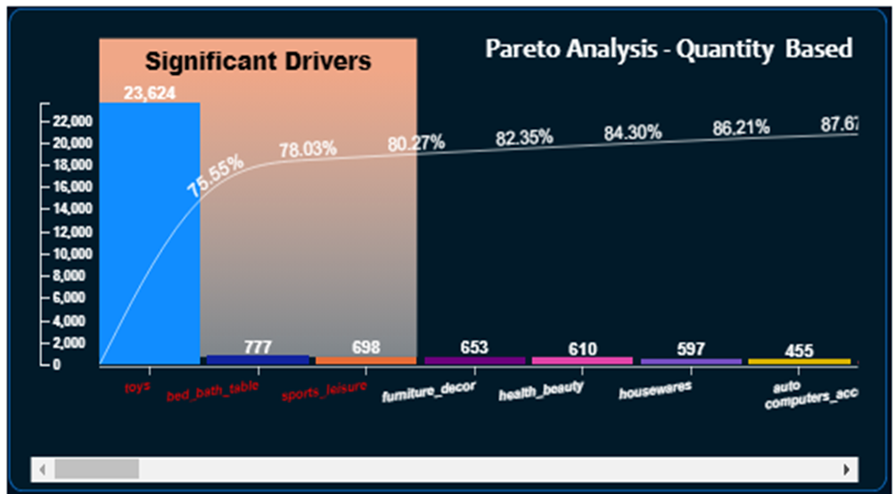
Quantity based Pareto analysis
•Toys, health_beauty and bed_bath_table make up 80.27% of the total orders.
•Toys alone has 75.55% of the total orders.
•The rest of the 70+ product categories generate 19.73% of the total orders
•Toys, health_beauty and bed_bath_table make up 80.27% of the total orders.
•Toys alone has 75.55% of the total orders.
•The rest of the 70+ product categories generate 19.73% of the total orders

Slide 9
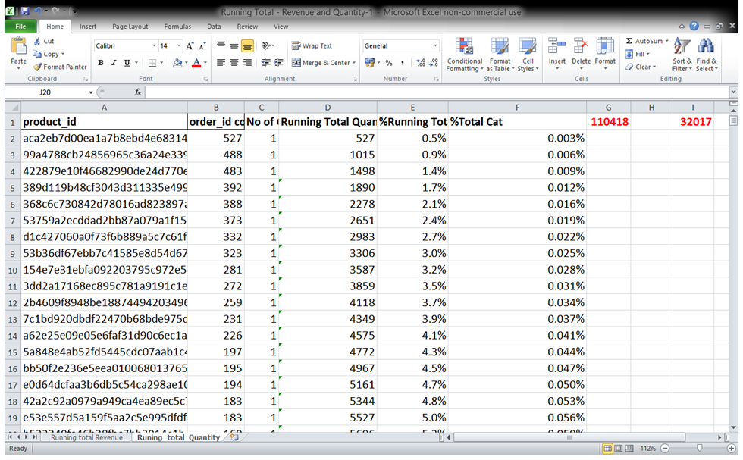
Percentage of quantity ordered as running total.
•The Percentage of quantity ordered shown as running total has been broken down by Product Id.
•The contribution of each product can be identified.

Slide 10
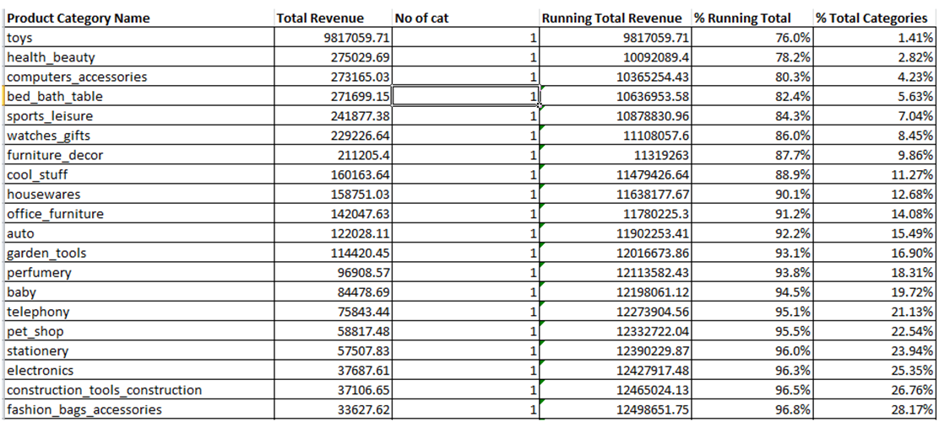
Percentage of revenue as running total
•The Percentage of revenue is shown as running total revenue.
•The contribution of each product category towards revenue can be identified.

Slide 11
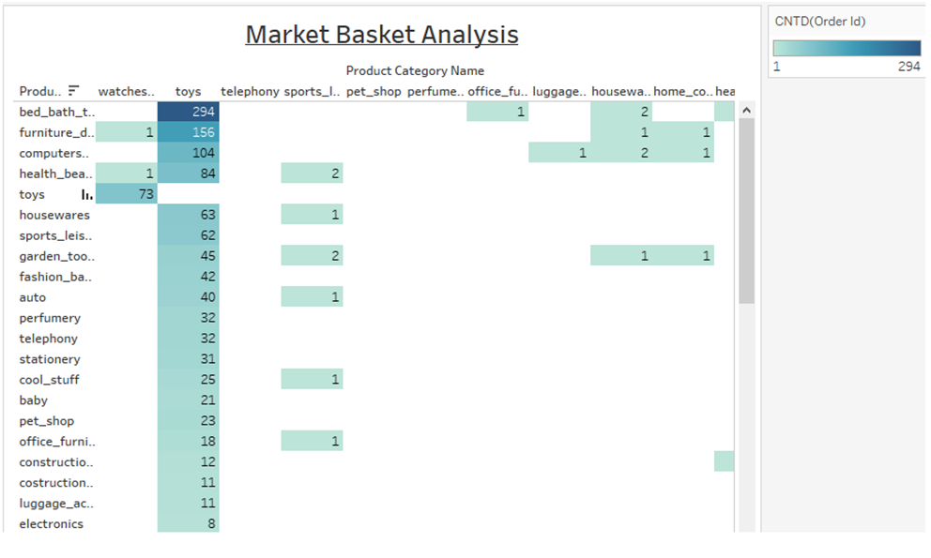
Market basket analysis
.Toys are the most ordered category along with categories of bed_bath_table, furniture_decor.
. Market basket analysis is performed to identify the frequently ordered category association.

Slide 12
Insights
The category Toys constitute 20% of the products which generates 80% of the revenue.
Apart from Toys, the products from the categories of bed_bath_table, furniture_decor, computer_accessories and health_beauty are the most frequently ordered.
The above categories with Toys or/and with each other are the most frequent in customers basket.
It can be observed that despite the price being high with certain products, the products were frequently purchased by the customers.
The category Toys constitute 20% of the products which generates 80% of the revenue.
Apart from Toys, the products from the categories of bed_bath_table, furniture_decor, computer_accessories and health_beauty are the most frequently ordered.
The above categories with Toys or/and with each other are the most frequent in customers basket.
It can be observed that despite the price being high with certain products, the products were frequently purchased by the customers.

Slide 13
Recommendations
The company should focus on the categories which generate more than 80% of the revenue by always keeping them in stock.
The company should target customers who are likely to buy toys to boost sales as the category toys is the most ordered category.
Offer discounts or promo-codes on the frequently ordered category associations to encourage cross-selling among the products.
Inventory of sub-categories which have very low sales can be reduced.
The company should focus on the categories which generate more than 80% of the revenue by always keeping them in stock.
The company should target customers who are likely to buy toys to boost sales as the category toys is the most ordered category.
Offer discounts or promo-codes on the frequently ordered category associations to encourage cross-selling among the products.
Inventory of sub-categories which have very low sales can be reduced.

Slide 14
Data methodology and assumptions
Dataset was cleaned, transformed and exploratory data analysis was done using the python library of pandas, Numpy and matplotlib.
Various visualizations and Market basket analysis was conducted using Power Bi and Tableau.
Redundant and duplicate records were discarded and only one occurrence was kept. The missing values for various columns were replaced with the best values.
Only cases having the status = ‘delivered’ were considered for this analysis.
The dataset was cleaned, transformed and exploratory data analysis was done using the python library of pandas, Numpy and matplotlib.
Various visualizations and Market basket analysis was conducted using Power Bi and Tableau.
Redundant and duplicate records were discarded and only one occurrence was kept. The missing values for various columns were replaced with the best values.
Only cases having the status = ‘delivered’ were considered for this analysis.

Slide 15
THANK YOU….

